Slide 1
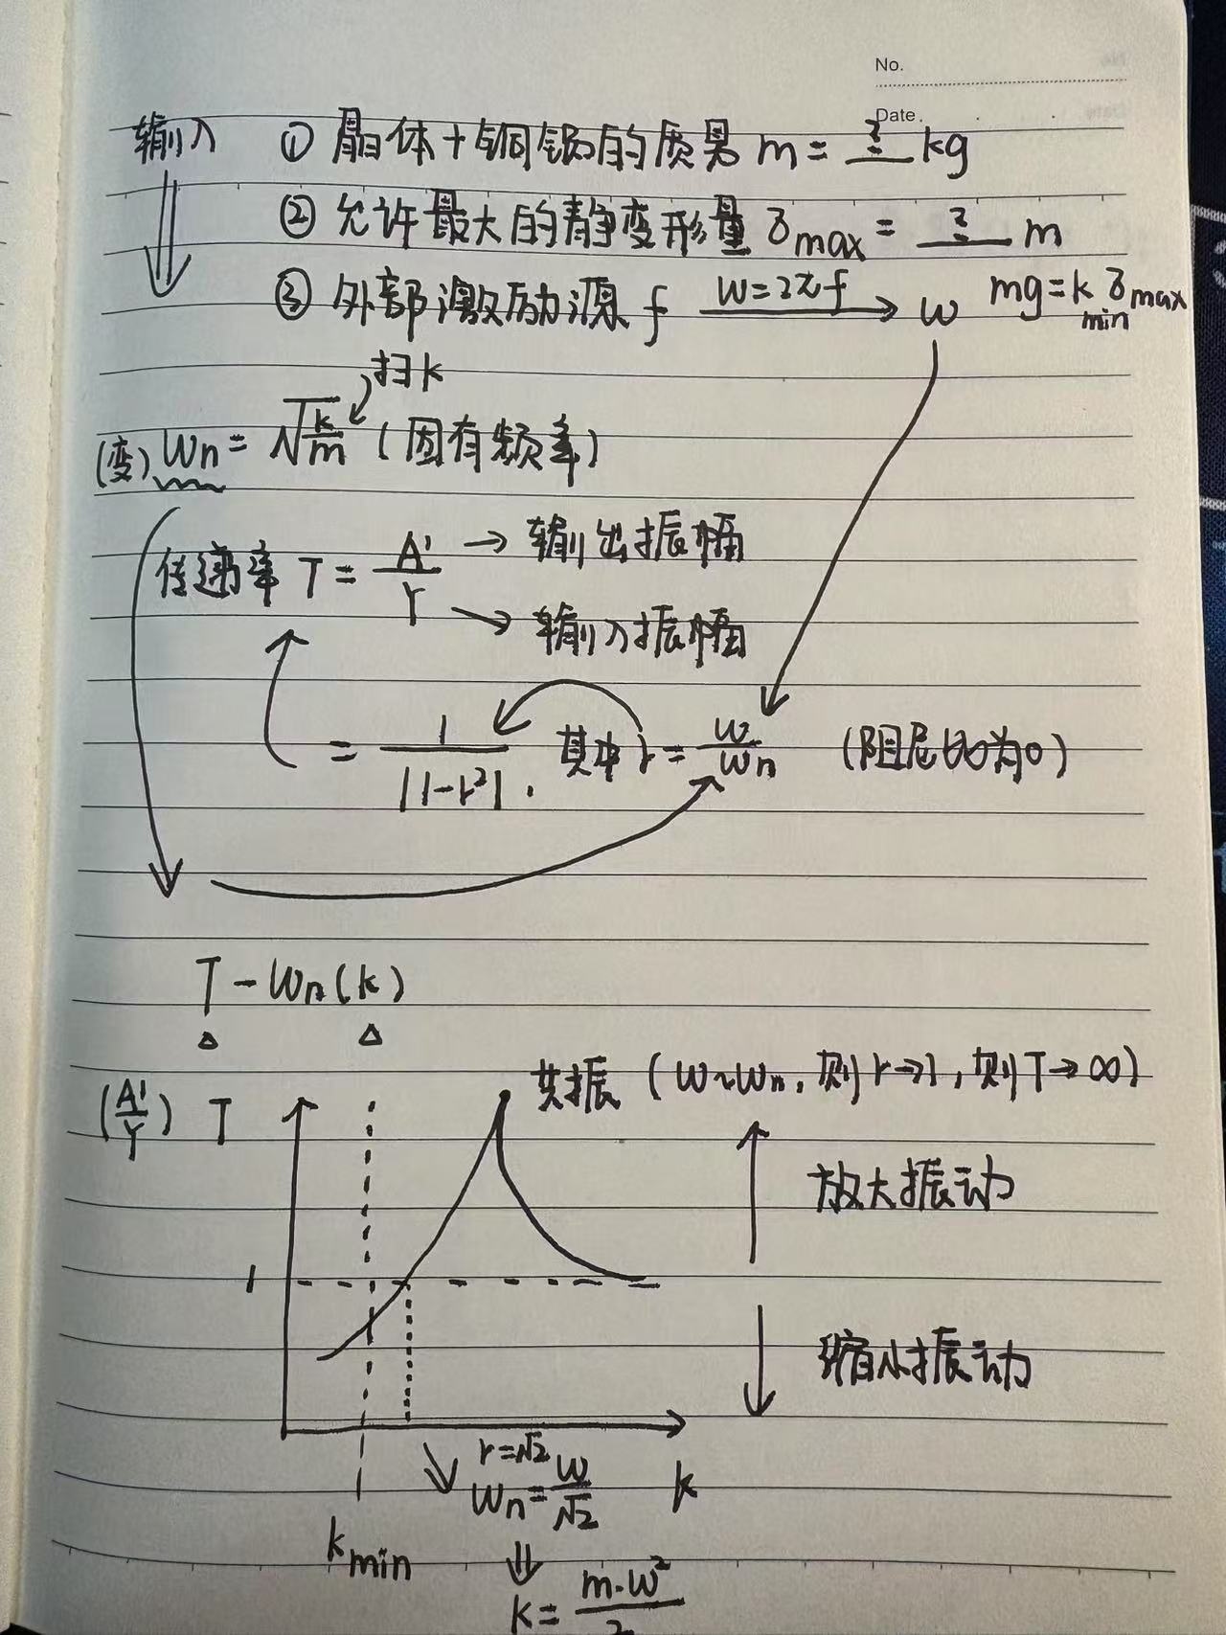
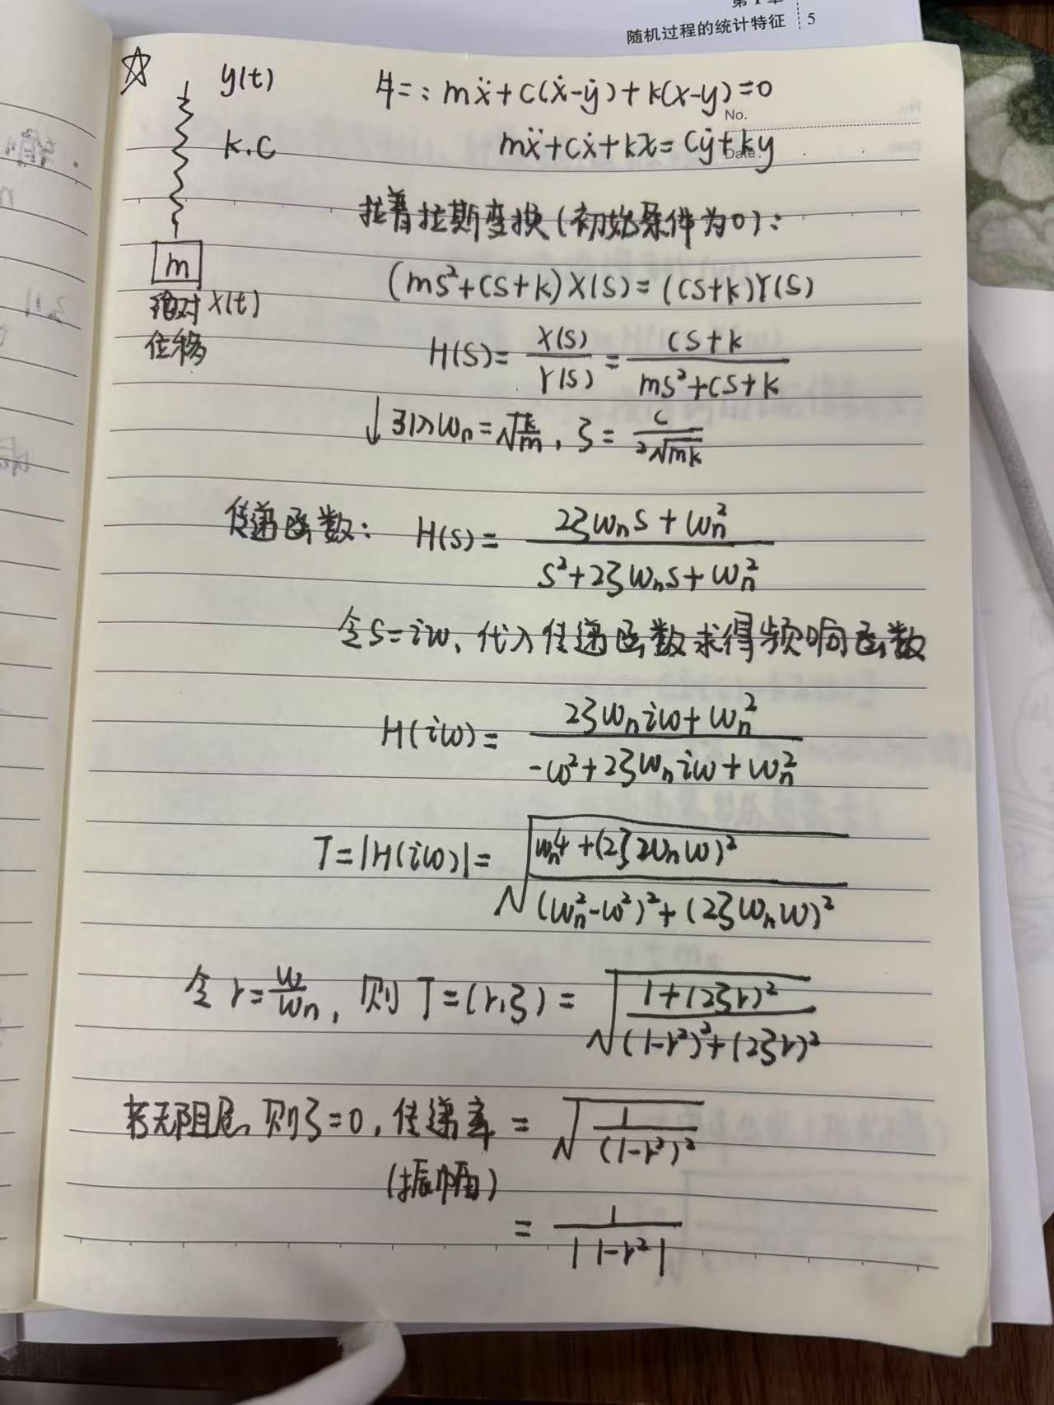
单个频率、无阻尼—寻找最佳k值

Slide 2

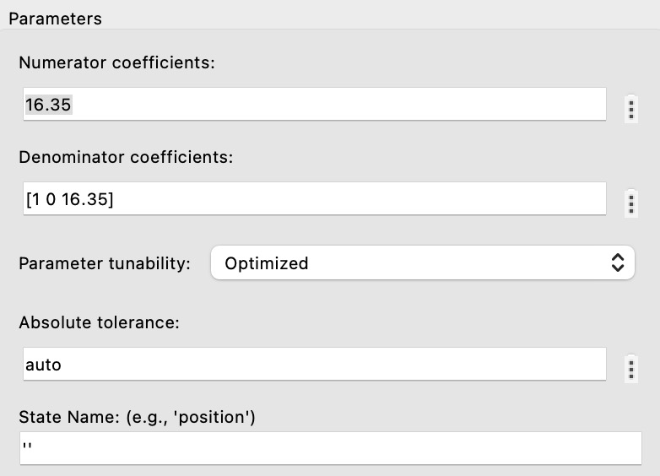
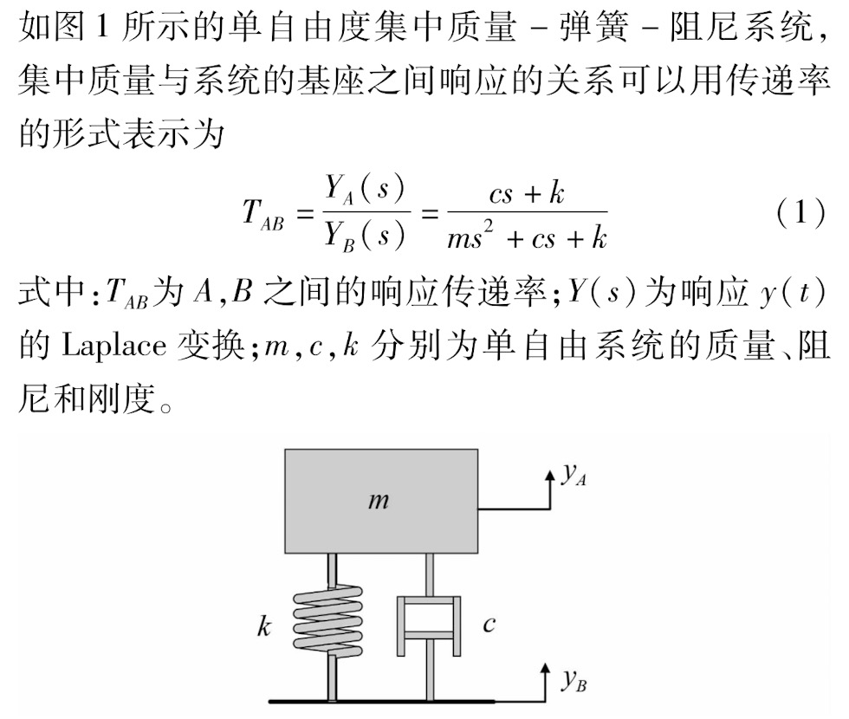
单个频率、无阻尼Matlab模拟
外部激励频率 W=10rad/sec，Amplitude=6

Slide 3
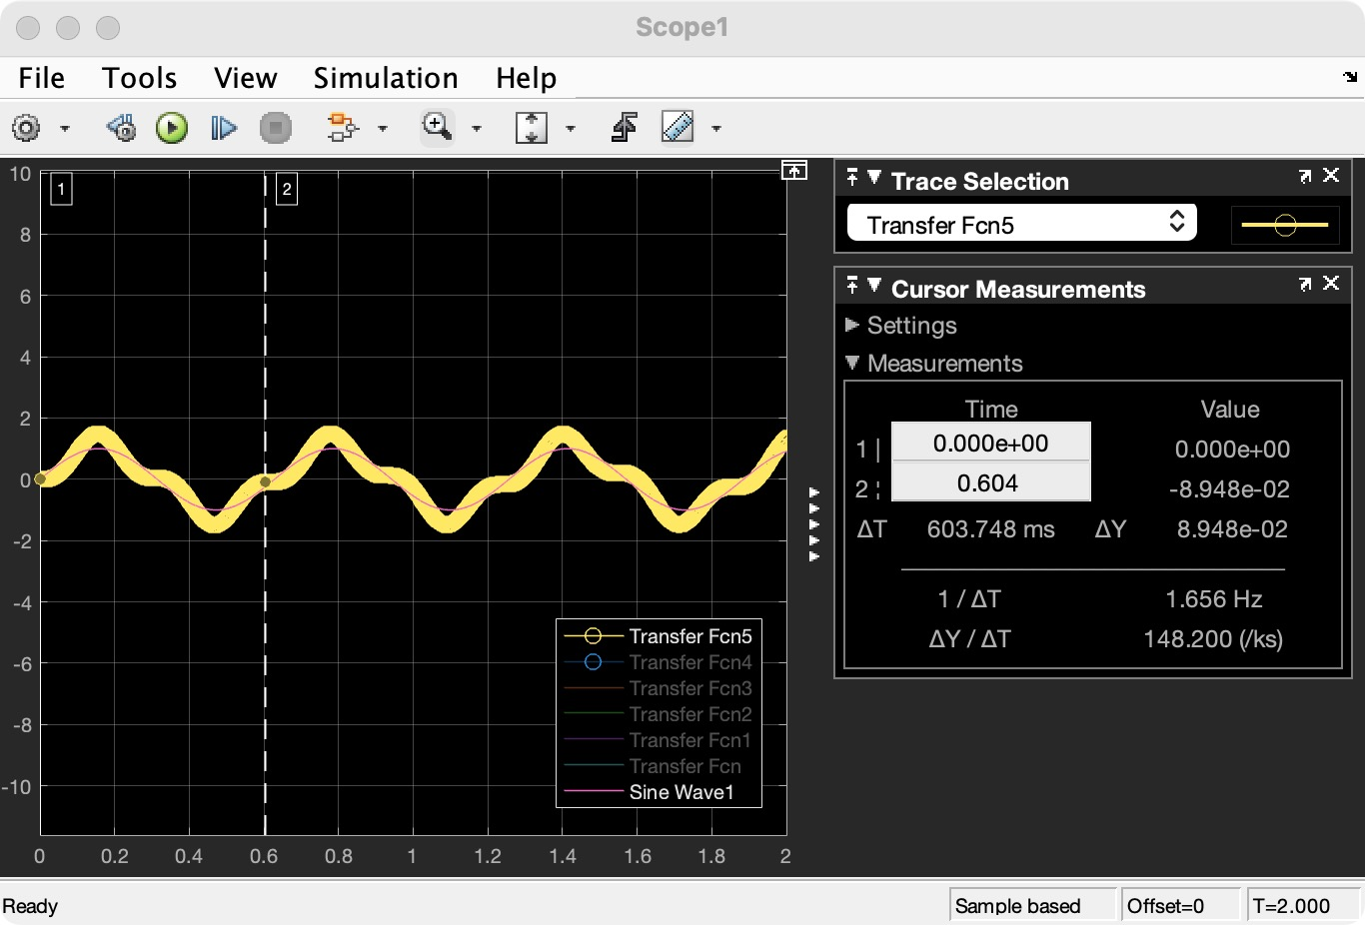
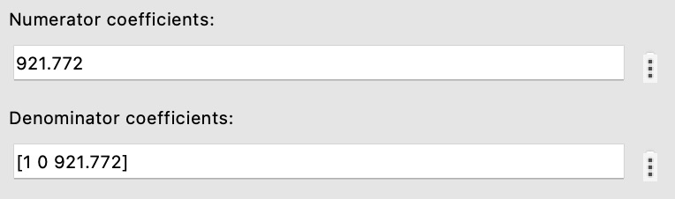
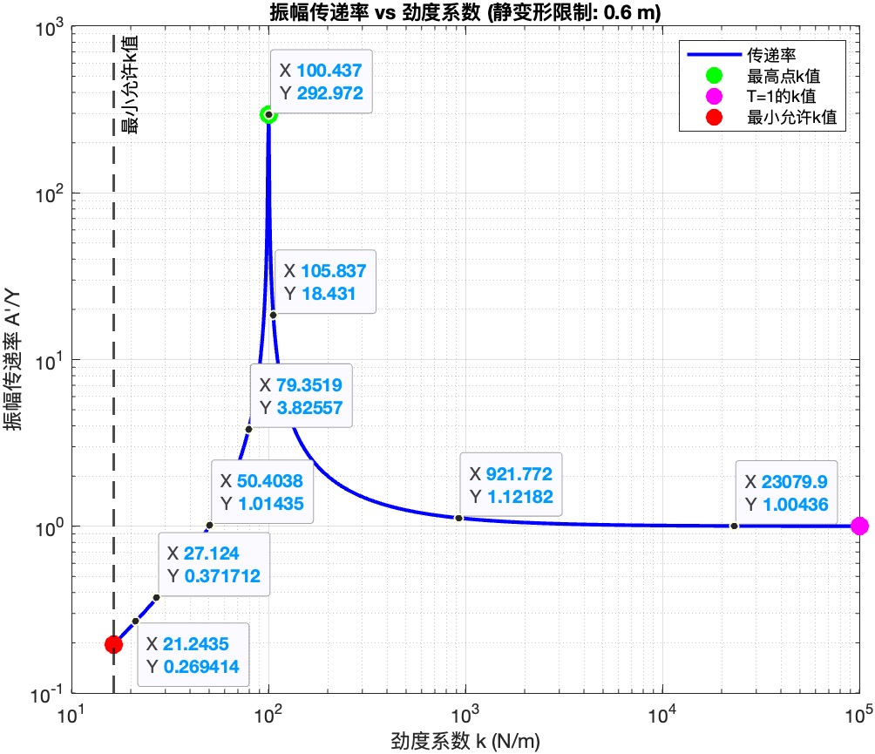
单个频率、无阻尼Matlab模拟
m=1kg，外部激励频率 W=10rad/sec

Slide 4
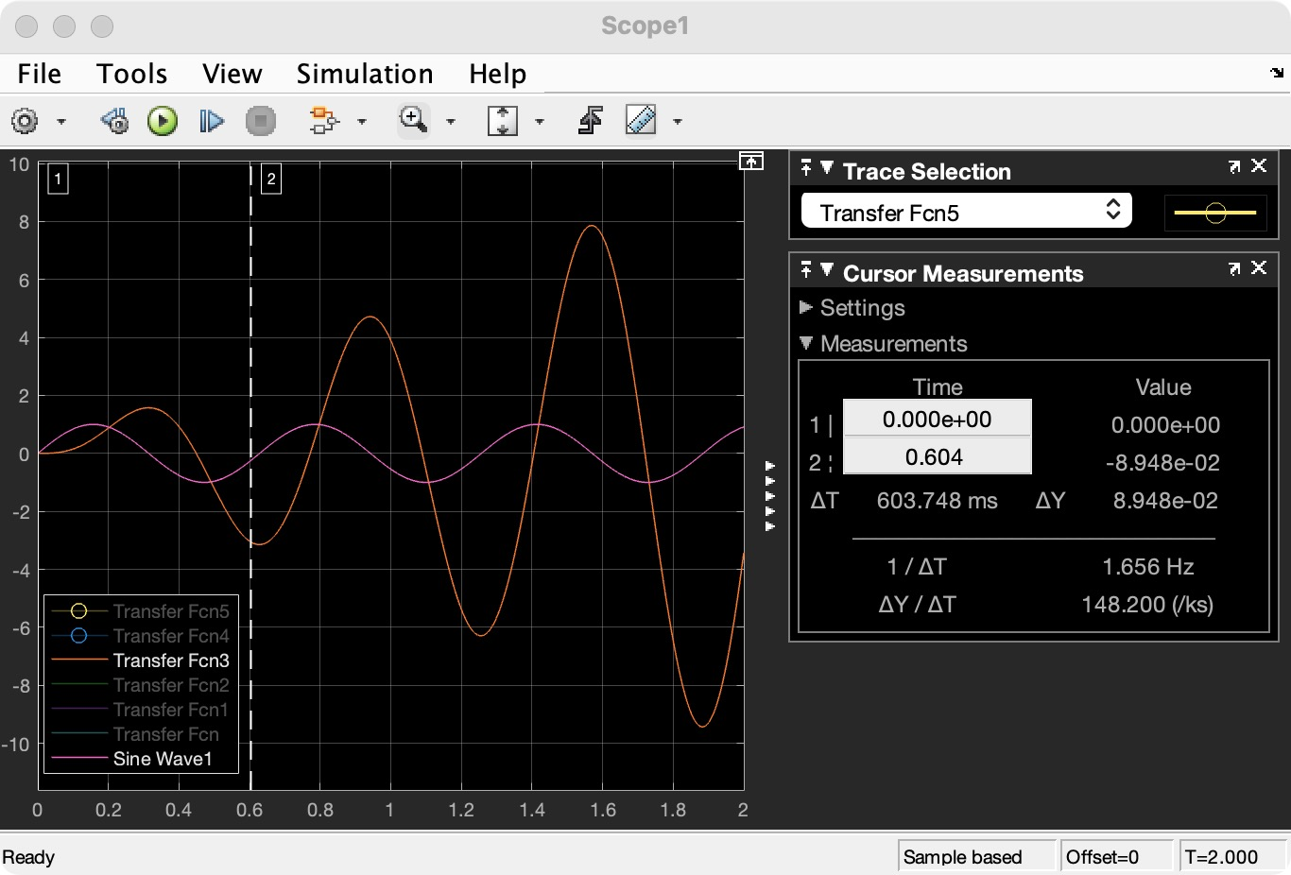
单个频率、无阻尼Matlab模拟
m=1kg，外部激励频率 W=10rad/sec

Slide 5
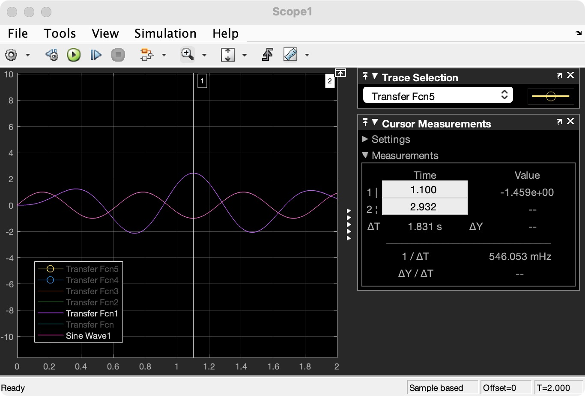
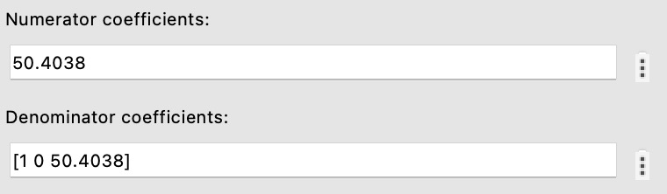
单个频率、无阻尼Matlab模拟
m=1kg，外部激励频率 W=10rad/sec

Slide 6
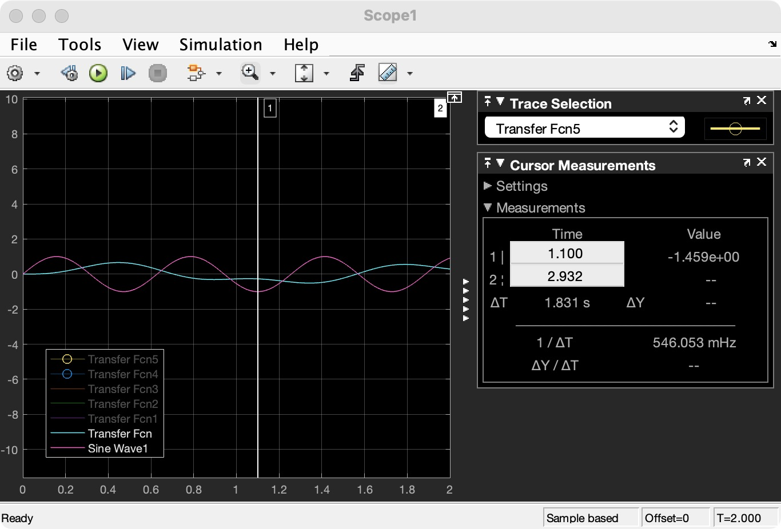
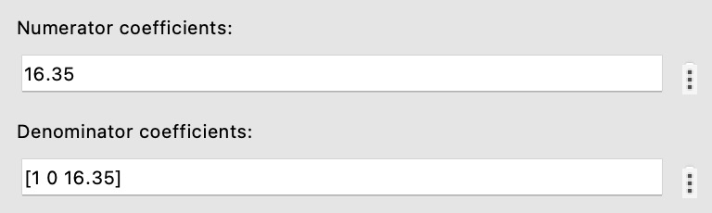
单个频率、无阻尼Matlab模拟
m=1kg，外部激励频率 W=10rad/sec

Slide 7
总结：单个频率、无阻尼
m=1kg，外部激励频率 W=10rad/sec，Amplitude=1.
无阻尼，K越小，传递率越小！

Slide 8
总结：单个频率、无阻尼

Slide 9
分析: 单个频率、无阻尼
M=4kg, Ms=0.6kg, 外部激励频率 W=10rad/sec. D:/RUNs/Vibration/vibra_300k_4hours_9.csv

Slide 10
分析: 单个频率、无阻尼
M=4kg, Ms=0.6kg, 外部激励频率 W=10rad/sec. D:/RUNs/Vibration/vibra_300k_4hours_9.csv

Slide 11
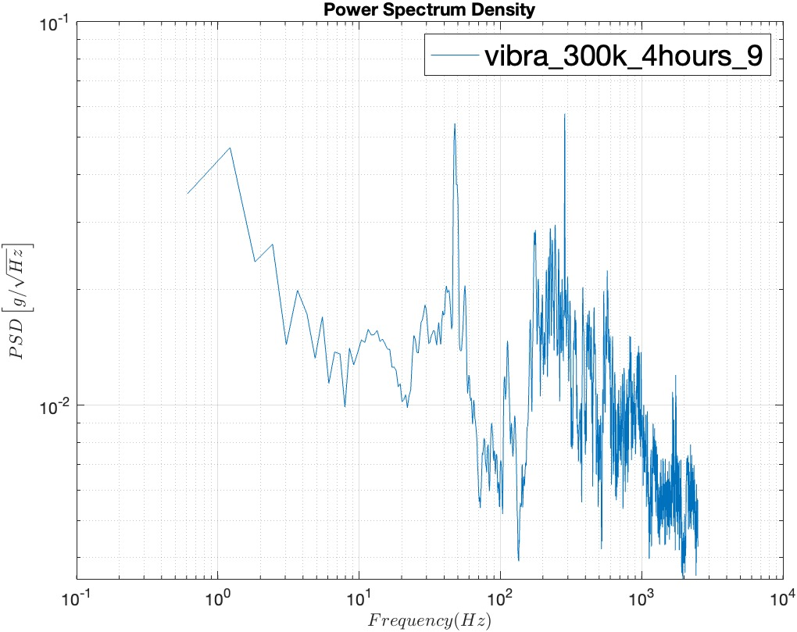
分析: 单个频率、无阻尼
M=4kg, Ms=0.6kg, 外部激励频率 W=10rad/sec. D:/RUNs/Vibration/vibra_300k_4hours_9.csv

Slide 12
分析: 单个频率、无阻尼
M=4kg, Ms=0.6kg, 外部激励频率 W=10rad/sec. D:/RUNs/Vibration/vibra_300k_4hours_9.csv

Slide 13
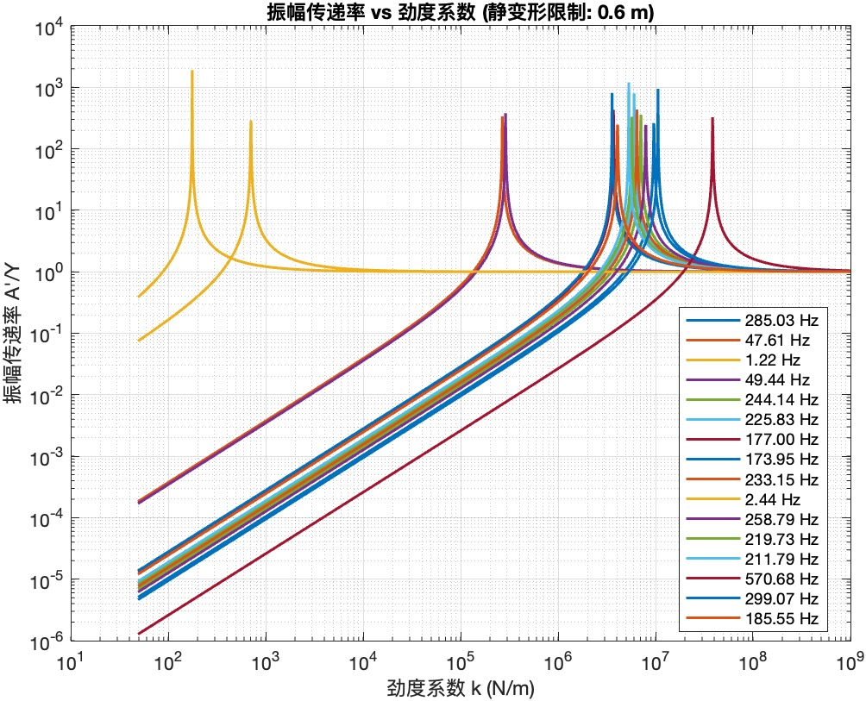
多个频率、无阻尼—寻找最佳k值
PSD图像提取主要频率 D:/RUNs/Vibration/vibra_300k_4hours_9.csv

Slide 14
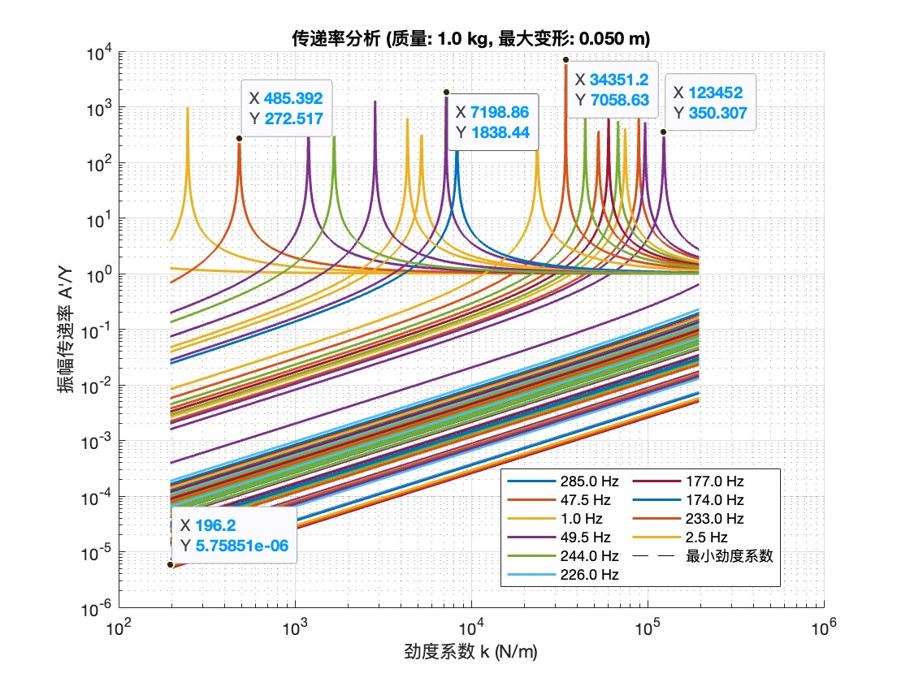
多个频率、无阻尼—寻找最佳k值
D:/RUNs/Vibration/vibra_300k_4hours_9.csv

Slide 15
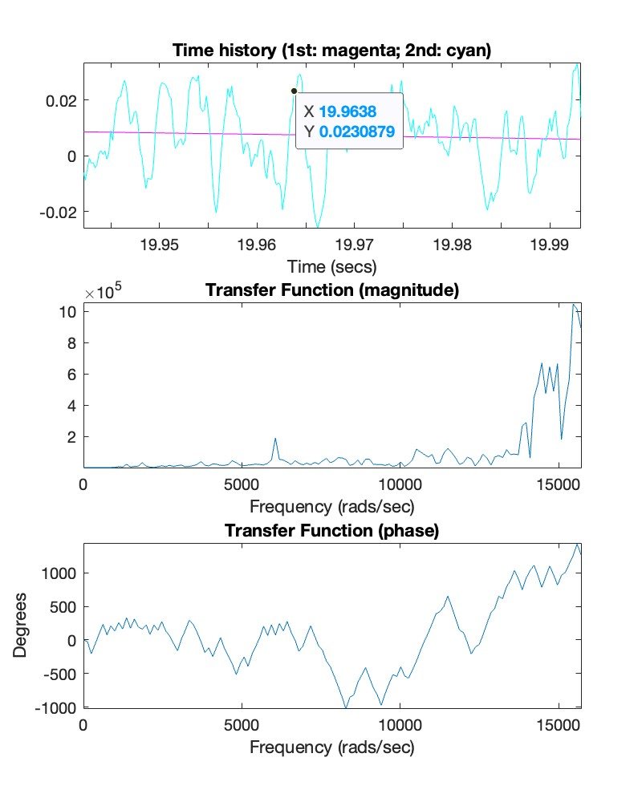
多个频率、无阻尼Matlab模拟
Stop time-1s k=196.2 N/m

Slide 16
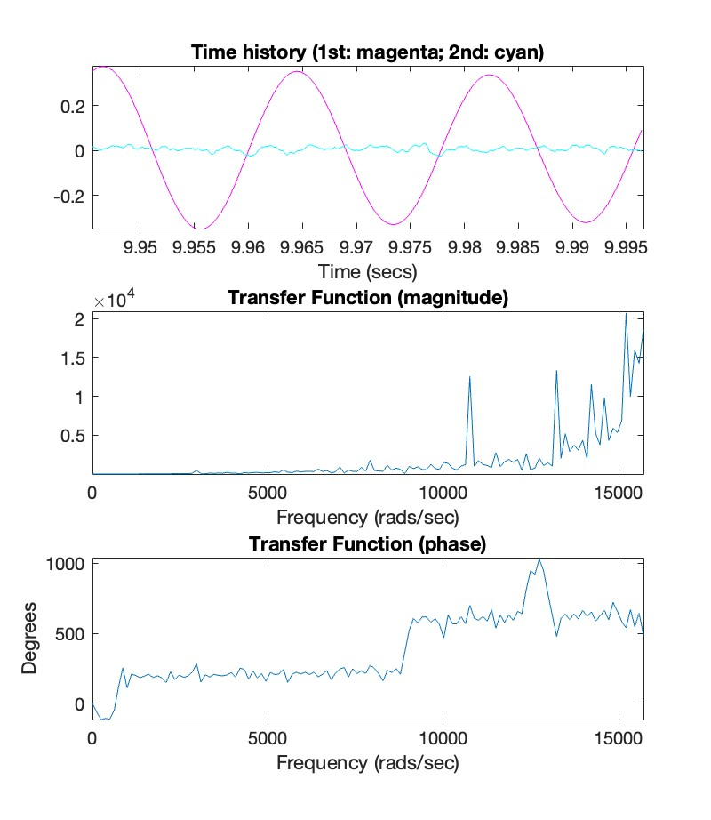
多个频率、无阻尼Matlab模拟
Stop time-1s k=485.392 N/m

Slide 17
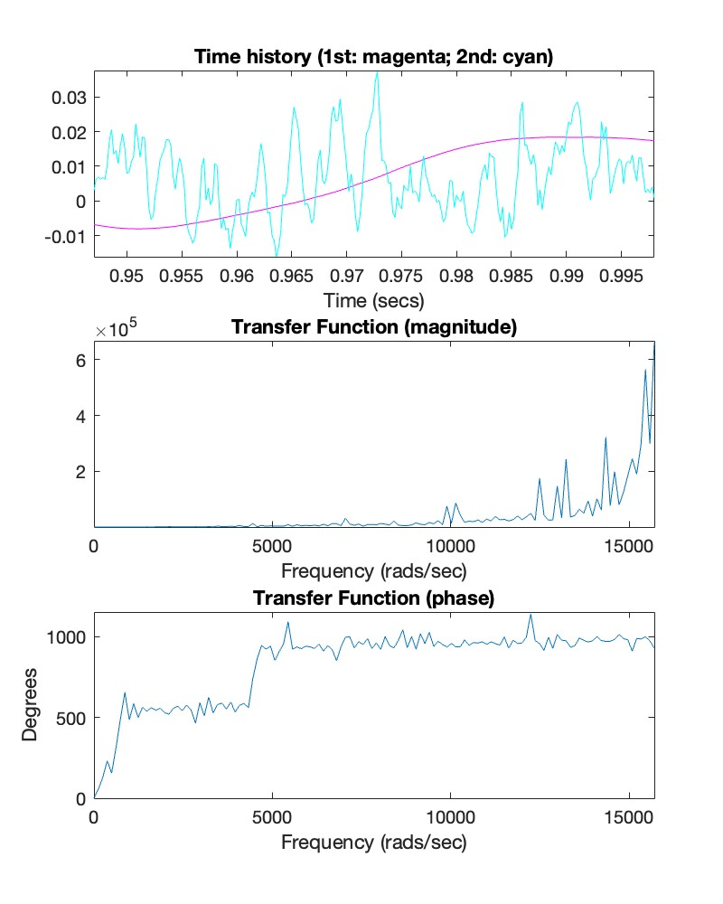
多个频率、无阻尼Matlab模拟
Stop time-1s k=7198.86 N/m

Slide 18
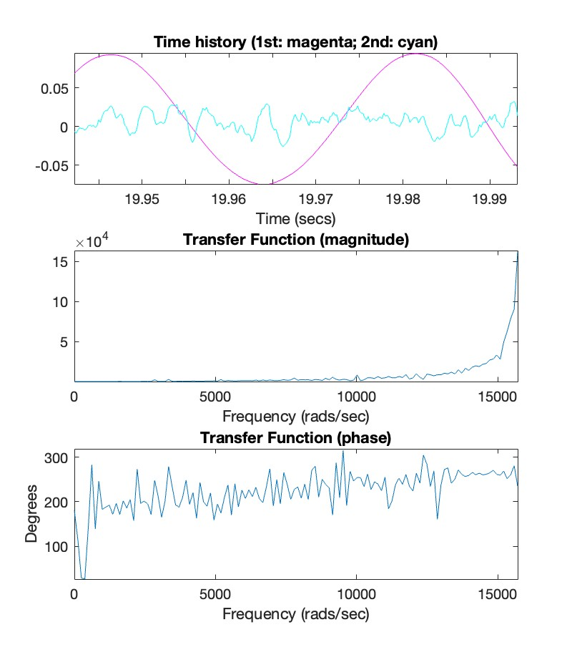
多个频率、无阻尼—寻找最佳k值
Stop time-20s k=34351.2 N/m

Slide 19
多个频率、无阻尼—寻找最佳k值
Stop time-1s k=123452 N/m

Slide 20
单个频率、有阻尼Matlab模拟
m=1kg，外部激励频率 W=10rad/sec

Slide 21
单个频率、有阻尼-无阻尼T-K图对比
C=0, 外部激励频率 W=10rad/sec
C=10Ns/m,外部激励频率 W=10rad/sec

Slide 22
单个频率、有阻尼Matlab模拟
m=1kg，外部激励频率 W=10rad/sec
C=10Ns/m,外部激励频率 W=10rad/sec

Slide 23
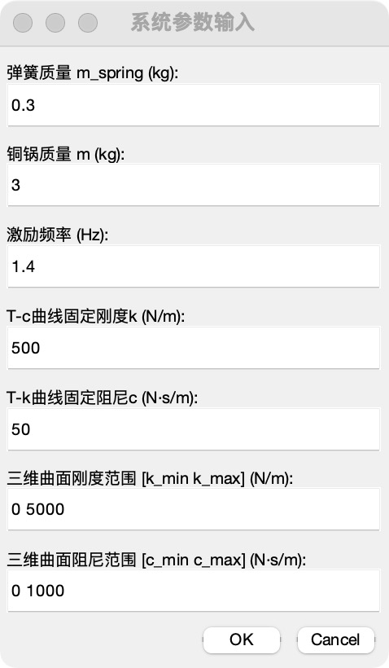
单个频率、有阻尼-寻找最佳k值

Slide 24
修正质量前后：单个频率、有阻尼-无阻尼T-K图对比
C=0, 外部激励频率 W=1.4HZ
C=50Ns/m,外部激励频率 W=1.4HZ

Slide 25
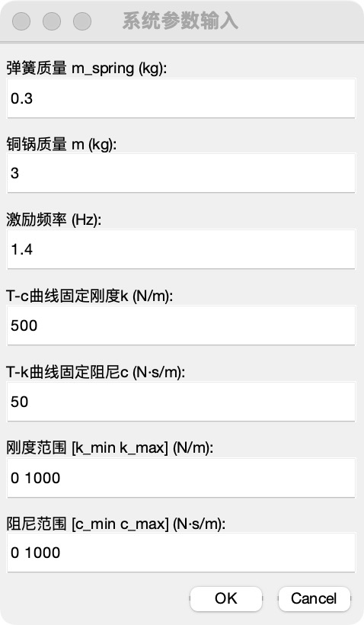
修正质量前后：单个频率、有阻尼对比
c=50Ns/m
k=500N/m

Slide 26
修正质量前后：单个频率、有阻尼-无阻尼对比

Slide 27
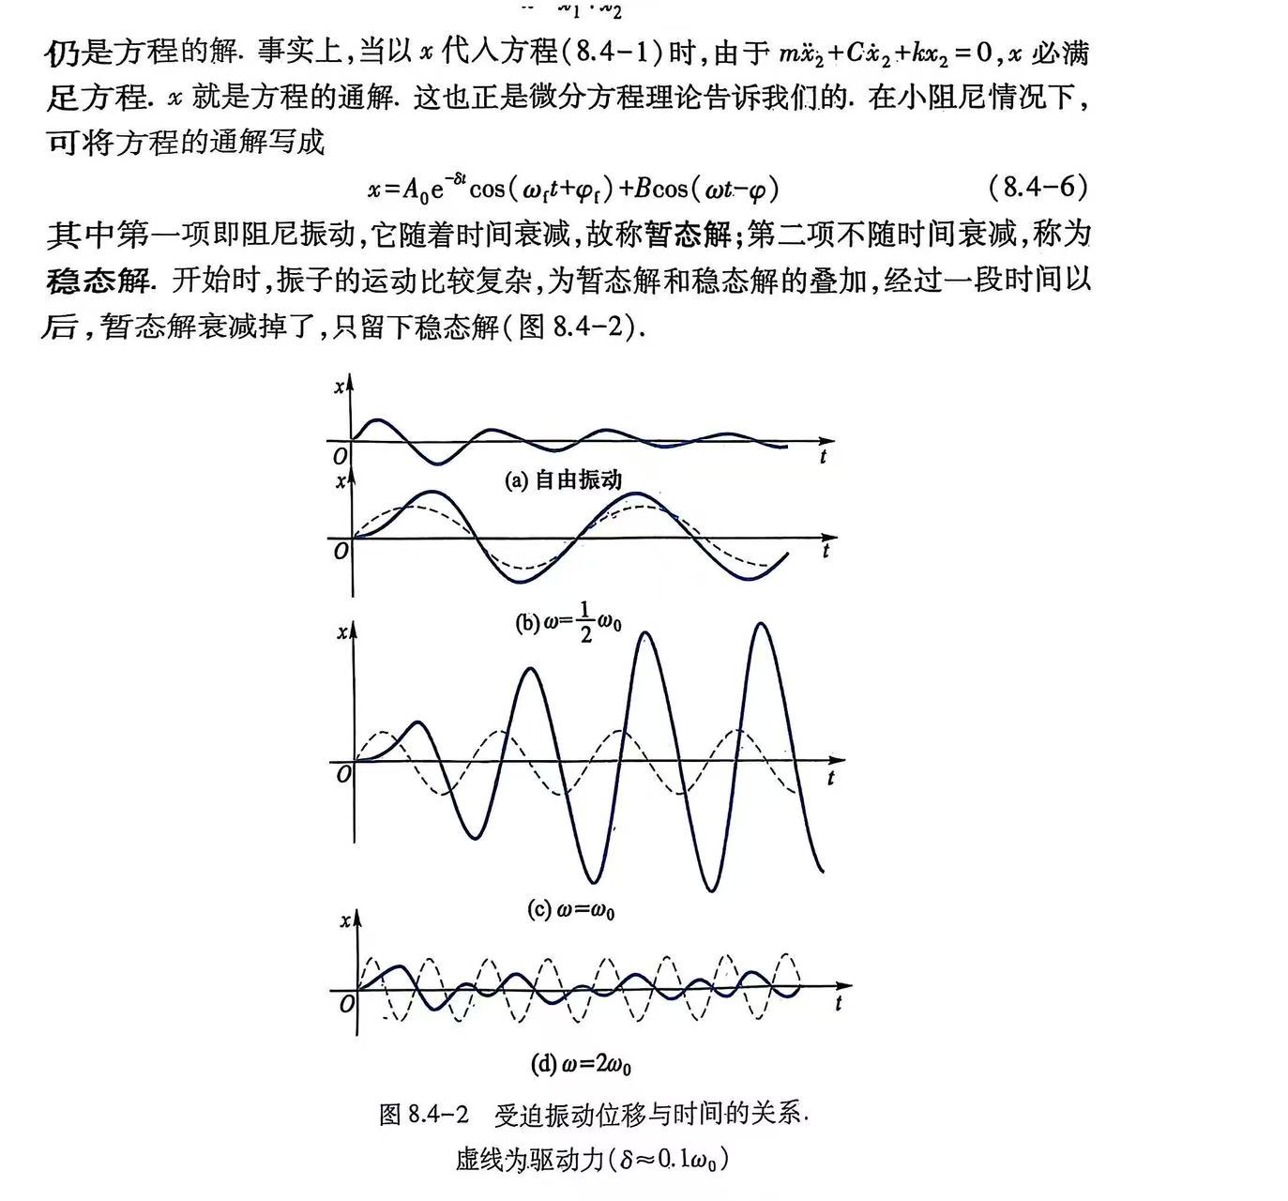
受迫振动Matlab模拟
m=1kg, k=1N/m, 激励频率 W=0，初速度0.5m/s

Slide 28
受迫振动Matlab模拟
m=1kg, k=1N/m, 外部激励频率 W=0.5rad/sec

Slide 29
受迫振动Matlab模拟
m=1kg, k=1N/m, 外部激励频率 W=1rad/sec

Slide 30
受迫振动Matlab模拟
m=1kg, k=1N/m, 外部激励频率 W=2rad/sec

Slide 31
受迫振动Matlab模拟
m=1kg, k=1N/m, 外部激励频率 W=10rad/sec

Slide 32
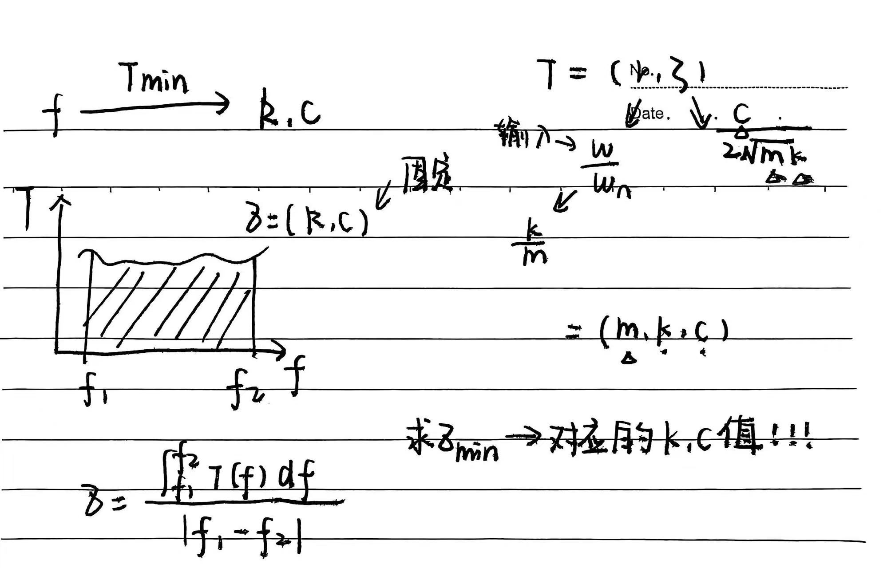
多个频率、有阻尼Matlab模拟
PSD提取频率—外部激励频率

Slide 33
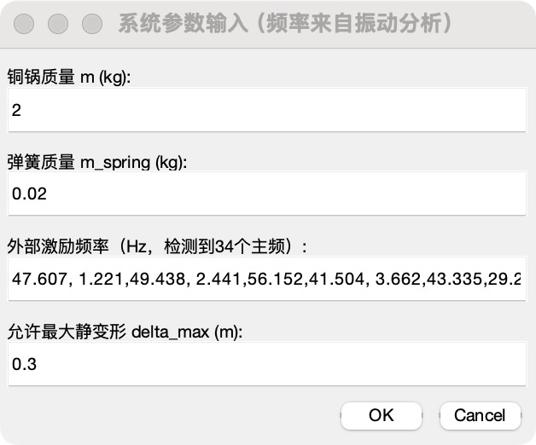
多个频率、有阻尼Matlab模拟
PSD提取频率—外部激励频率

Slide 34
多个频率、有阻尼Matlab模拟-不同阻尼1vs10

Slide 35
多个频率、有阻尼Matlab模拟-不同阻尼1vs1000

Slide 36
振动传递率T
m=4.2kg, 外部激励频率 W=10rad/sec

Slide 37
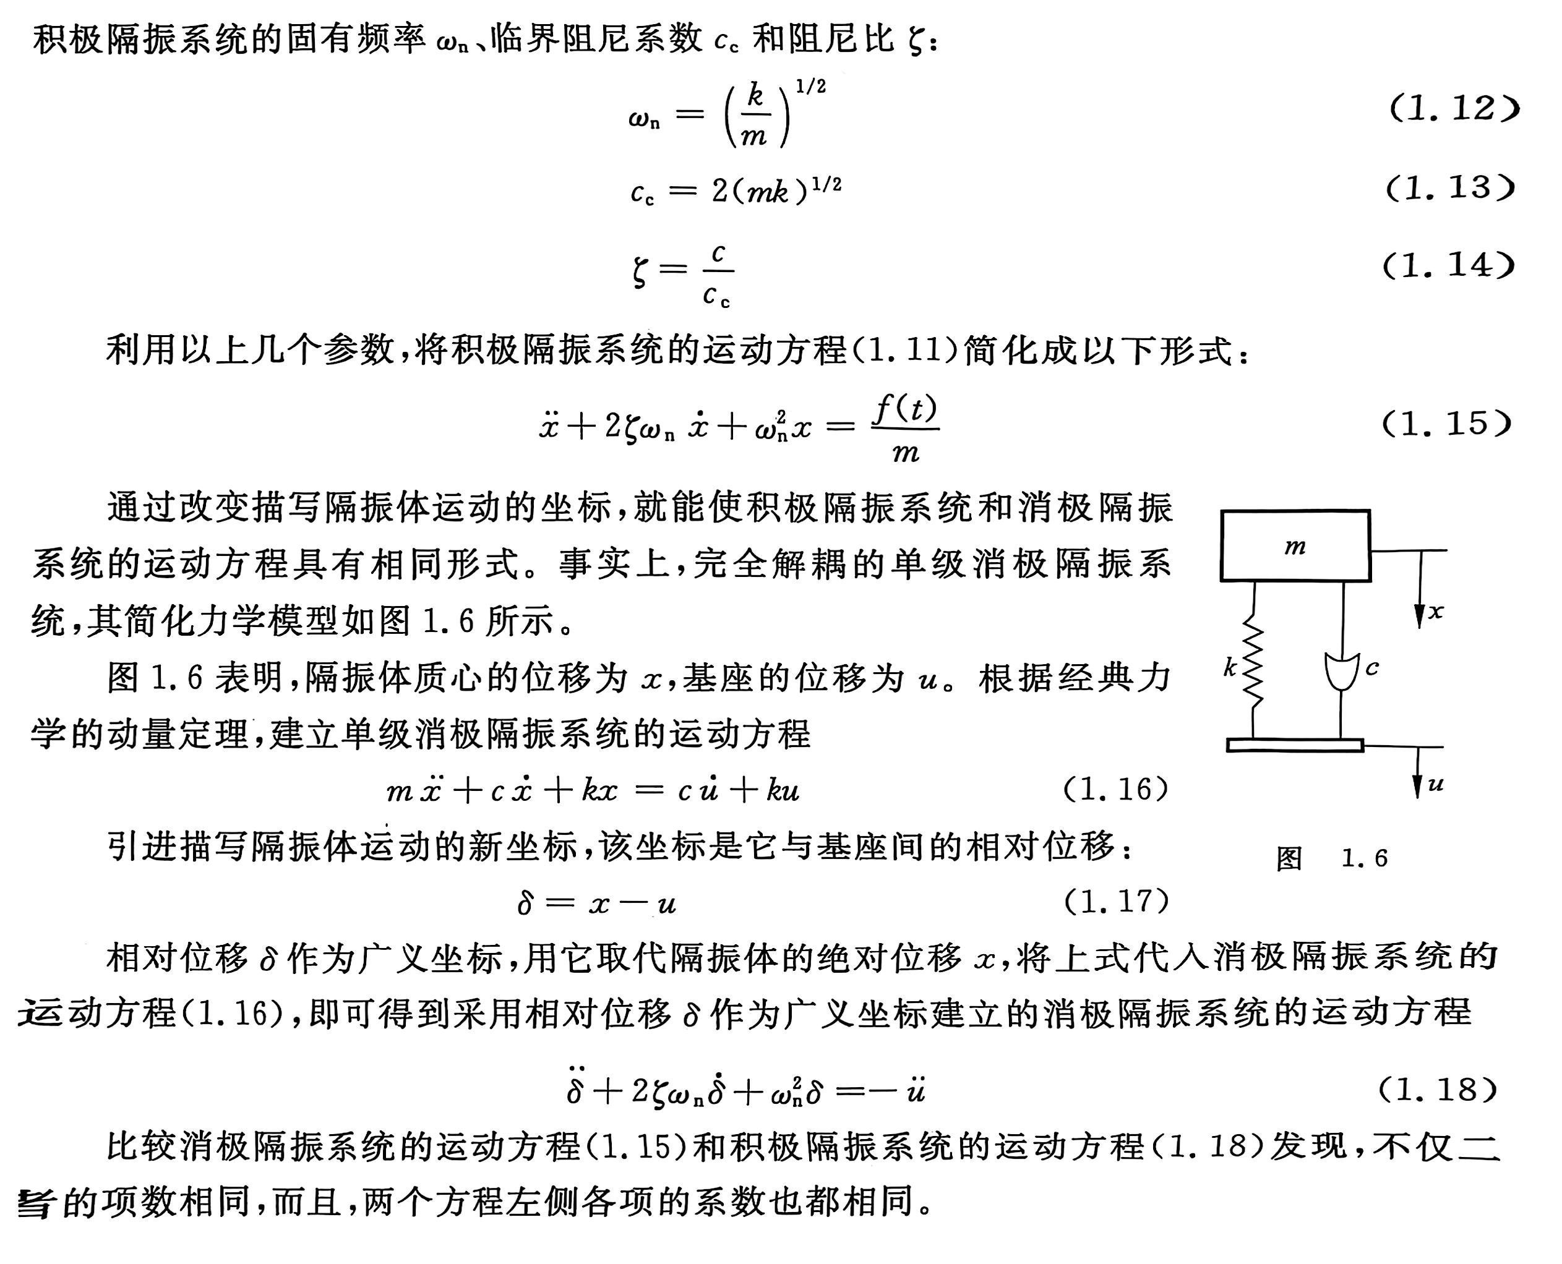
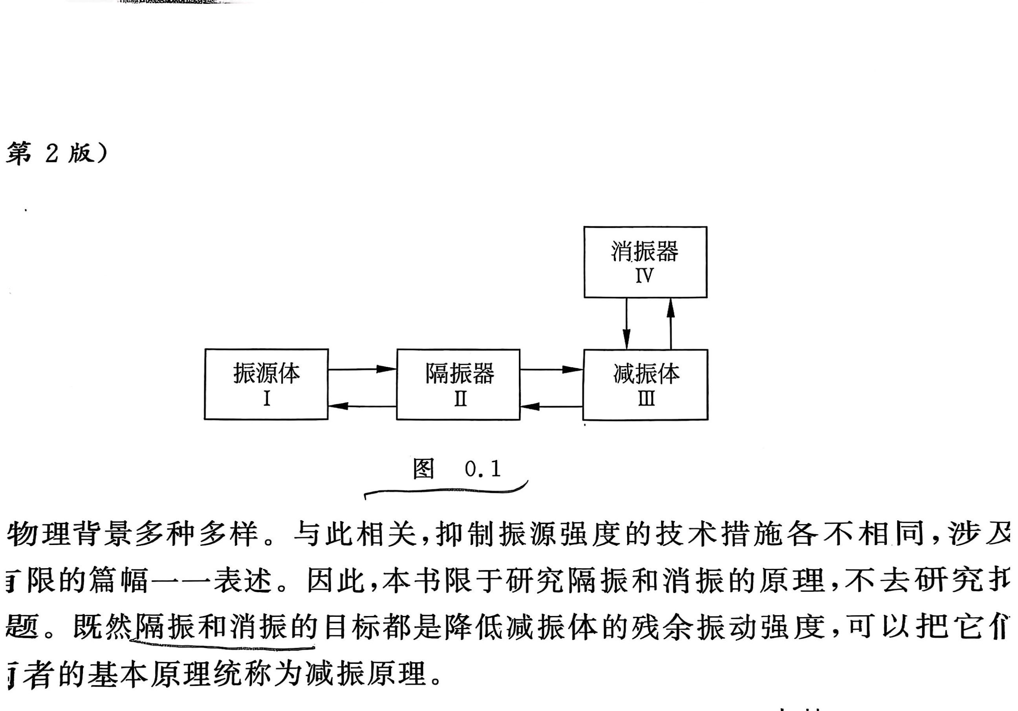
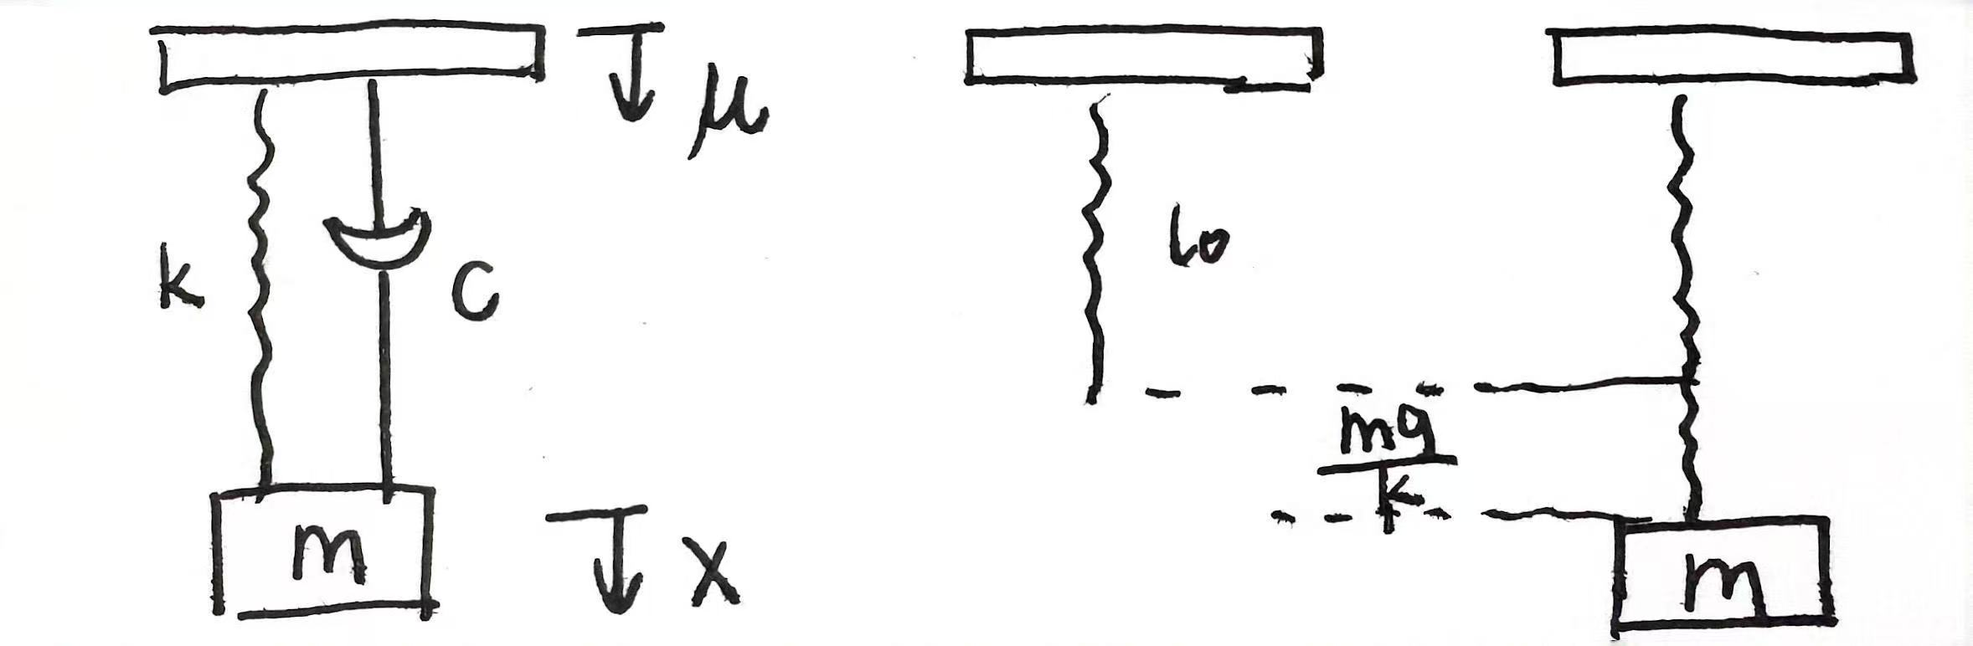
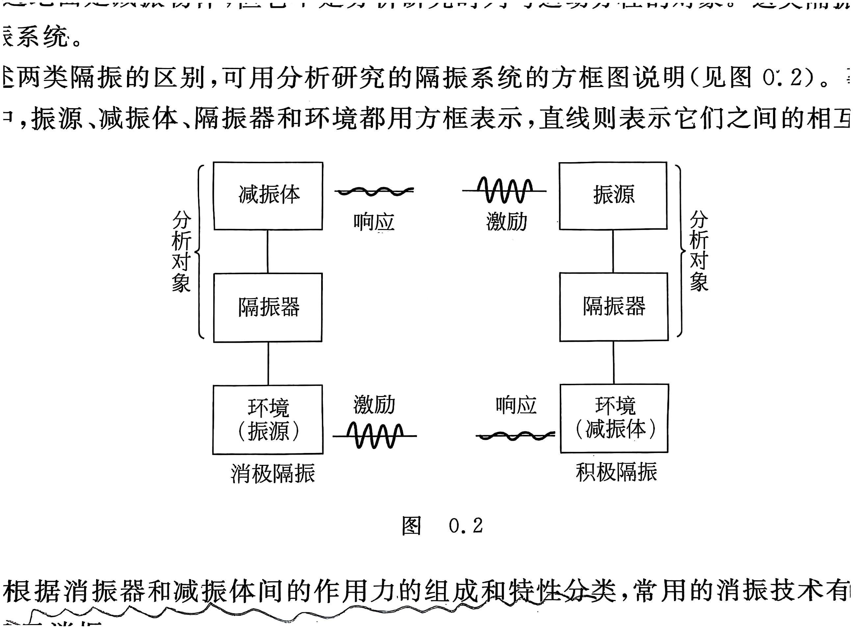
减振
抑制振源强度
隔振
消振

Slide 38
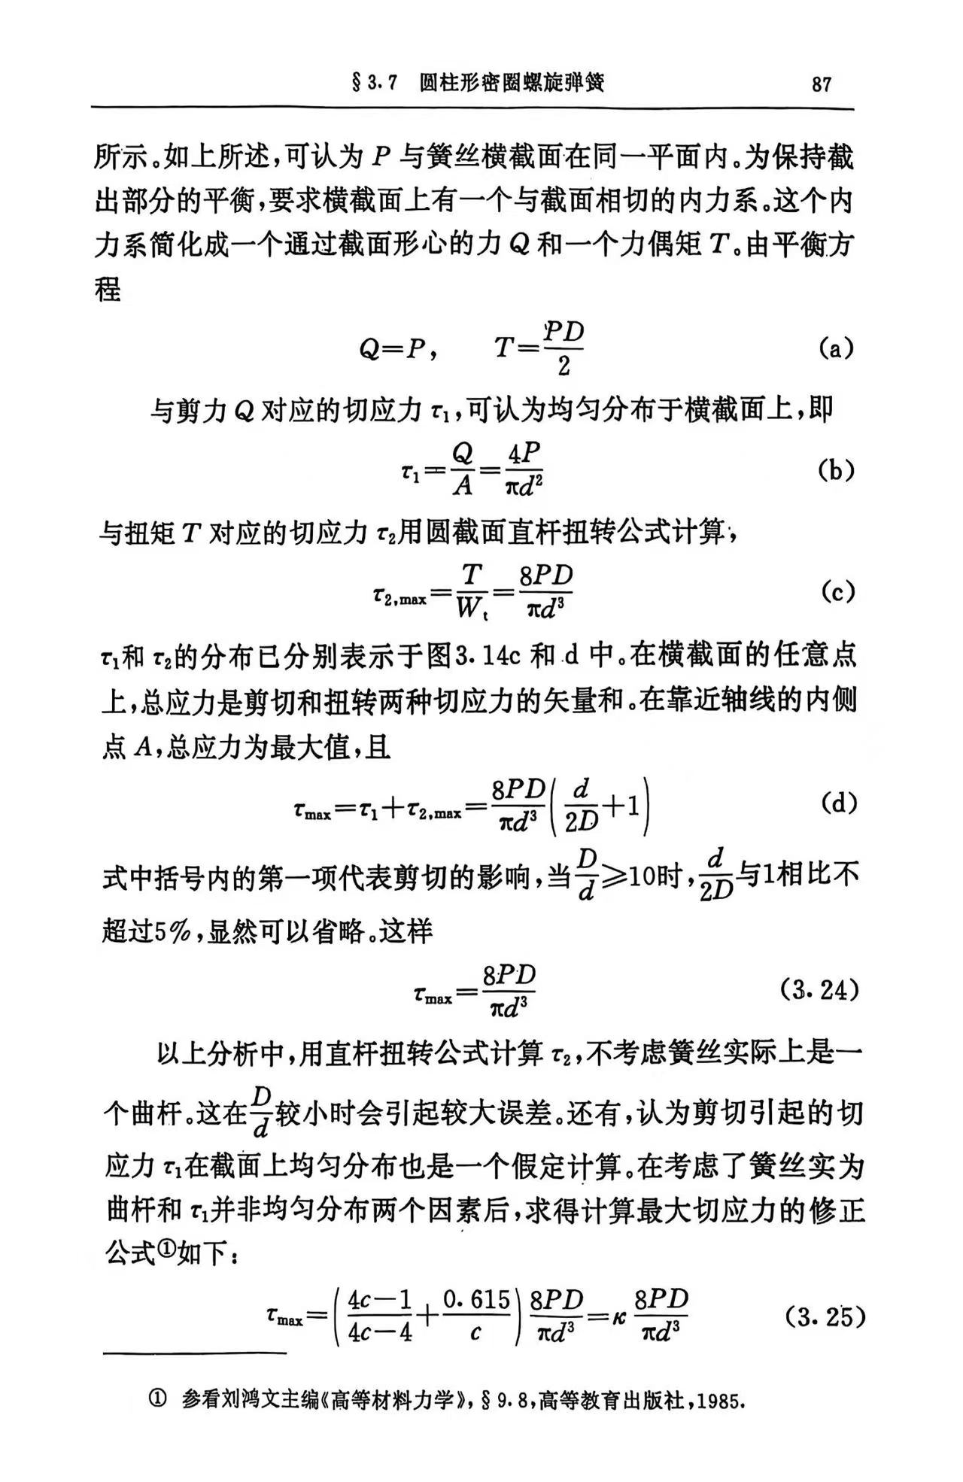
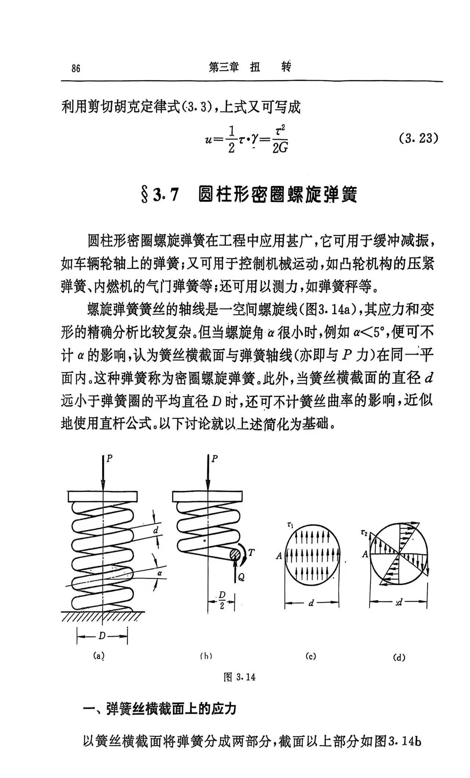
K的范围
遍历D和d
遍历N

Slide 39
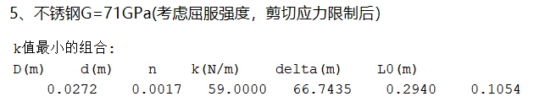
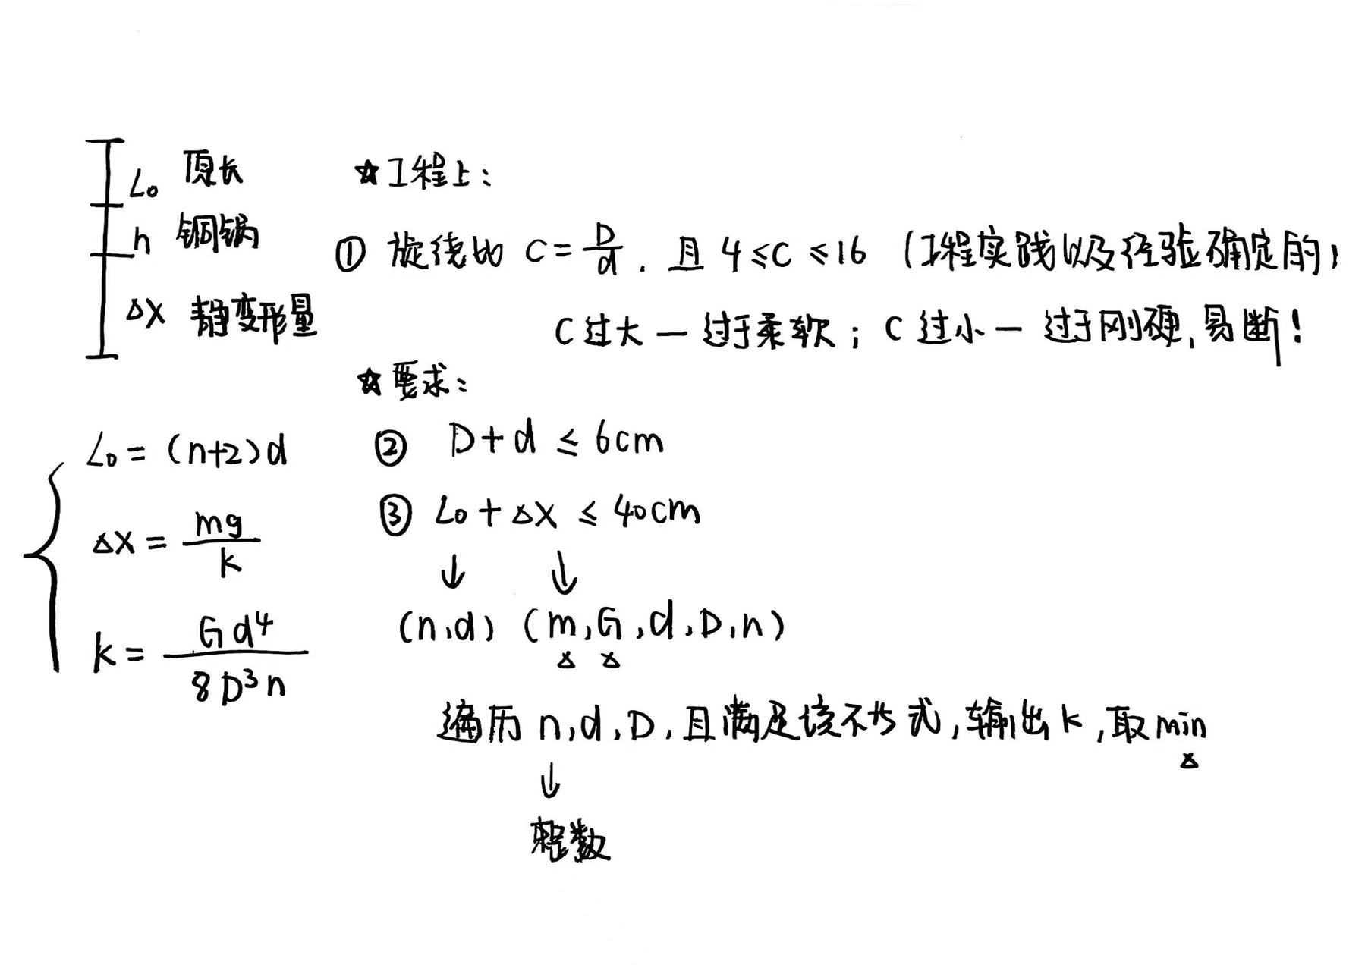
单根弹簧—Kmin

Slide 40
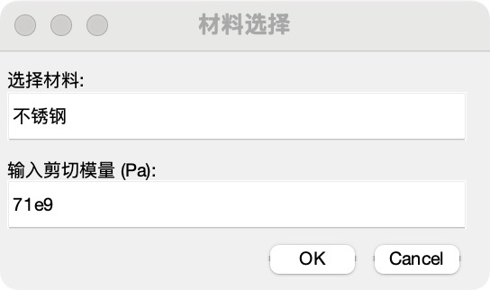
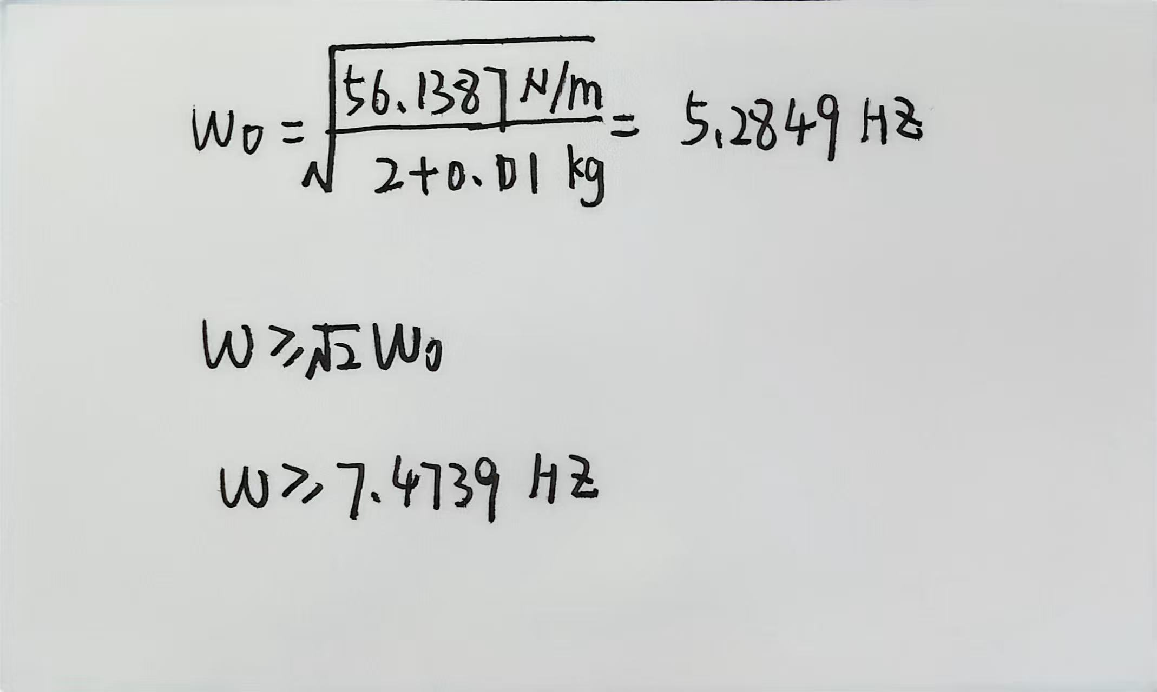
单根弹簧—Kmin

Slide 41
增大空间限制-原长+伸长量小于50cm

Slide 42
增大空间限制-原长+伸长量小于50cm

Slide 43
增大空间限制-原长+伸长量小于50cm

Slide 44
准零刚度隔离器（Quasi-zero Stiffness, QZS）
This mechanical metamaterial can significantly shield vibrations over almost the entire measured frequency band, from as low as 0.1–25 Hz.
Apply: Acoustic cloaking 声隐身 、Acoustic metamaterials 声超材料
隐身潜艇、超声成像的分辨率和准确性；制造高性能的声学隐身材料，提高建筑物的隔音效果

Slide 45
准零刚度隔离器（Quasi-zero Stiffness, QZS）
✨The payload does not “feel” the input mechanical energy.
✨allow the energy to circulate between the shell and the energy source
Energy bypass ——“deviate”
Requires:materials to be rigorously distributed in spacefollowing preciously defined mathematical expressions.
Energy localization ——“confine”（ a local resonance）
Requires: using a local resonance usually performs well in a limited frequency regime and at a specific frequency.
In a practical application, the localized energy is easily transferred into other forms, such as heat or electromagnetic radiation, which might have a band effect on the surrounding environment.

Slide 46
准零刚度隔离器（Quasi-zero Stiffness, QZS）
θdecreases—stored in the system
θincreases—released to the surroundings
A dynamic input force F ( t )
-a constant force Mg

Slide 47
准零刚度隔离器（Quasi-zero Stiffness, QZS）
负载质量M>>隔离器m 本文 M≈10m
Curable resin ——framework of the sample
Stainless-steel rods ——as hinges to join the elements together
Rubber stoppers ——keep the hinge tight.
Springs utilized ——MiSUMi-VONA
algorithm (GA)
K1——UFSP12-1.2-90
K2——WFSP9-1.2-30

Slide 48
准零刚度隔离器（Quasi-zero Stiffness, QZS）
The present mechanical metamaterial has absolute-zero-stiffness and thus can function as a vibration isolator for the full frequency band.
In our experiment, M ≈10 m. Therefore, the performance in ultra-low frequency is not as good as higher frequency.

Slide 49
疑惑
1. 低频部分的阻尼规律对应不上
2.传递函数—奇怪
3.旋绕比范围的确定

Slide 50
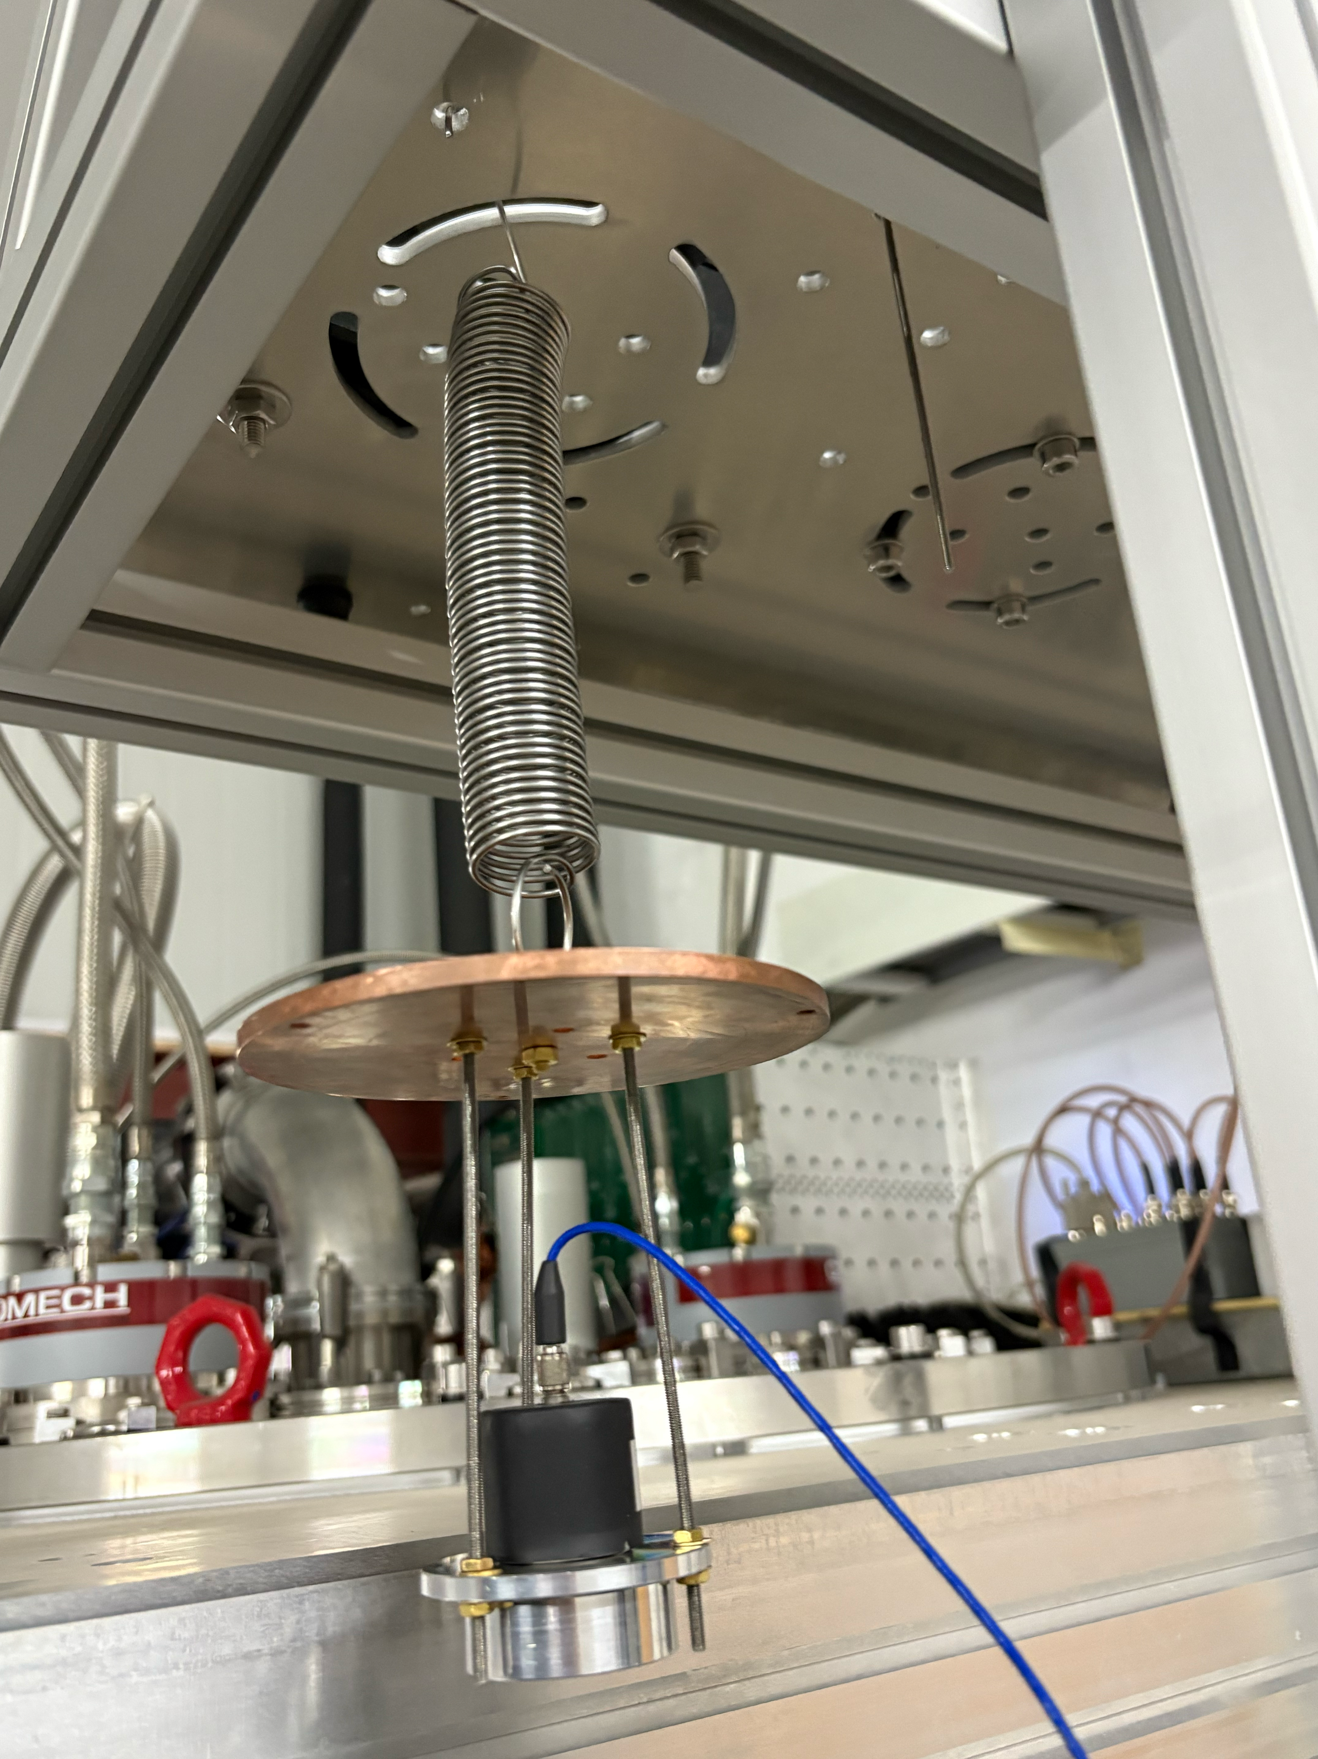
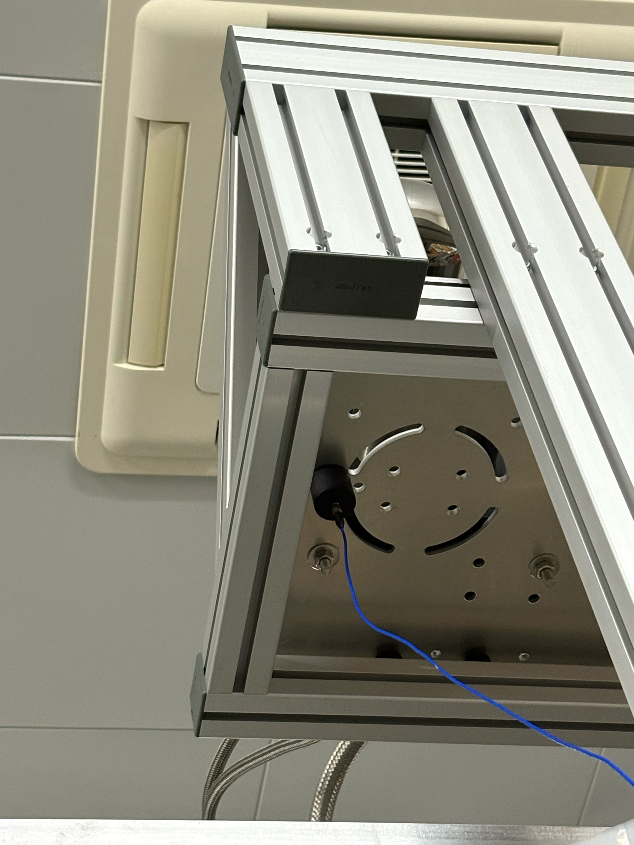
弹簧测试
pt_board
Spring

Slide 51
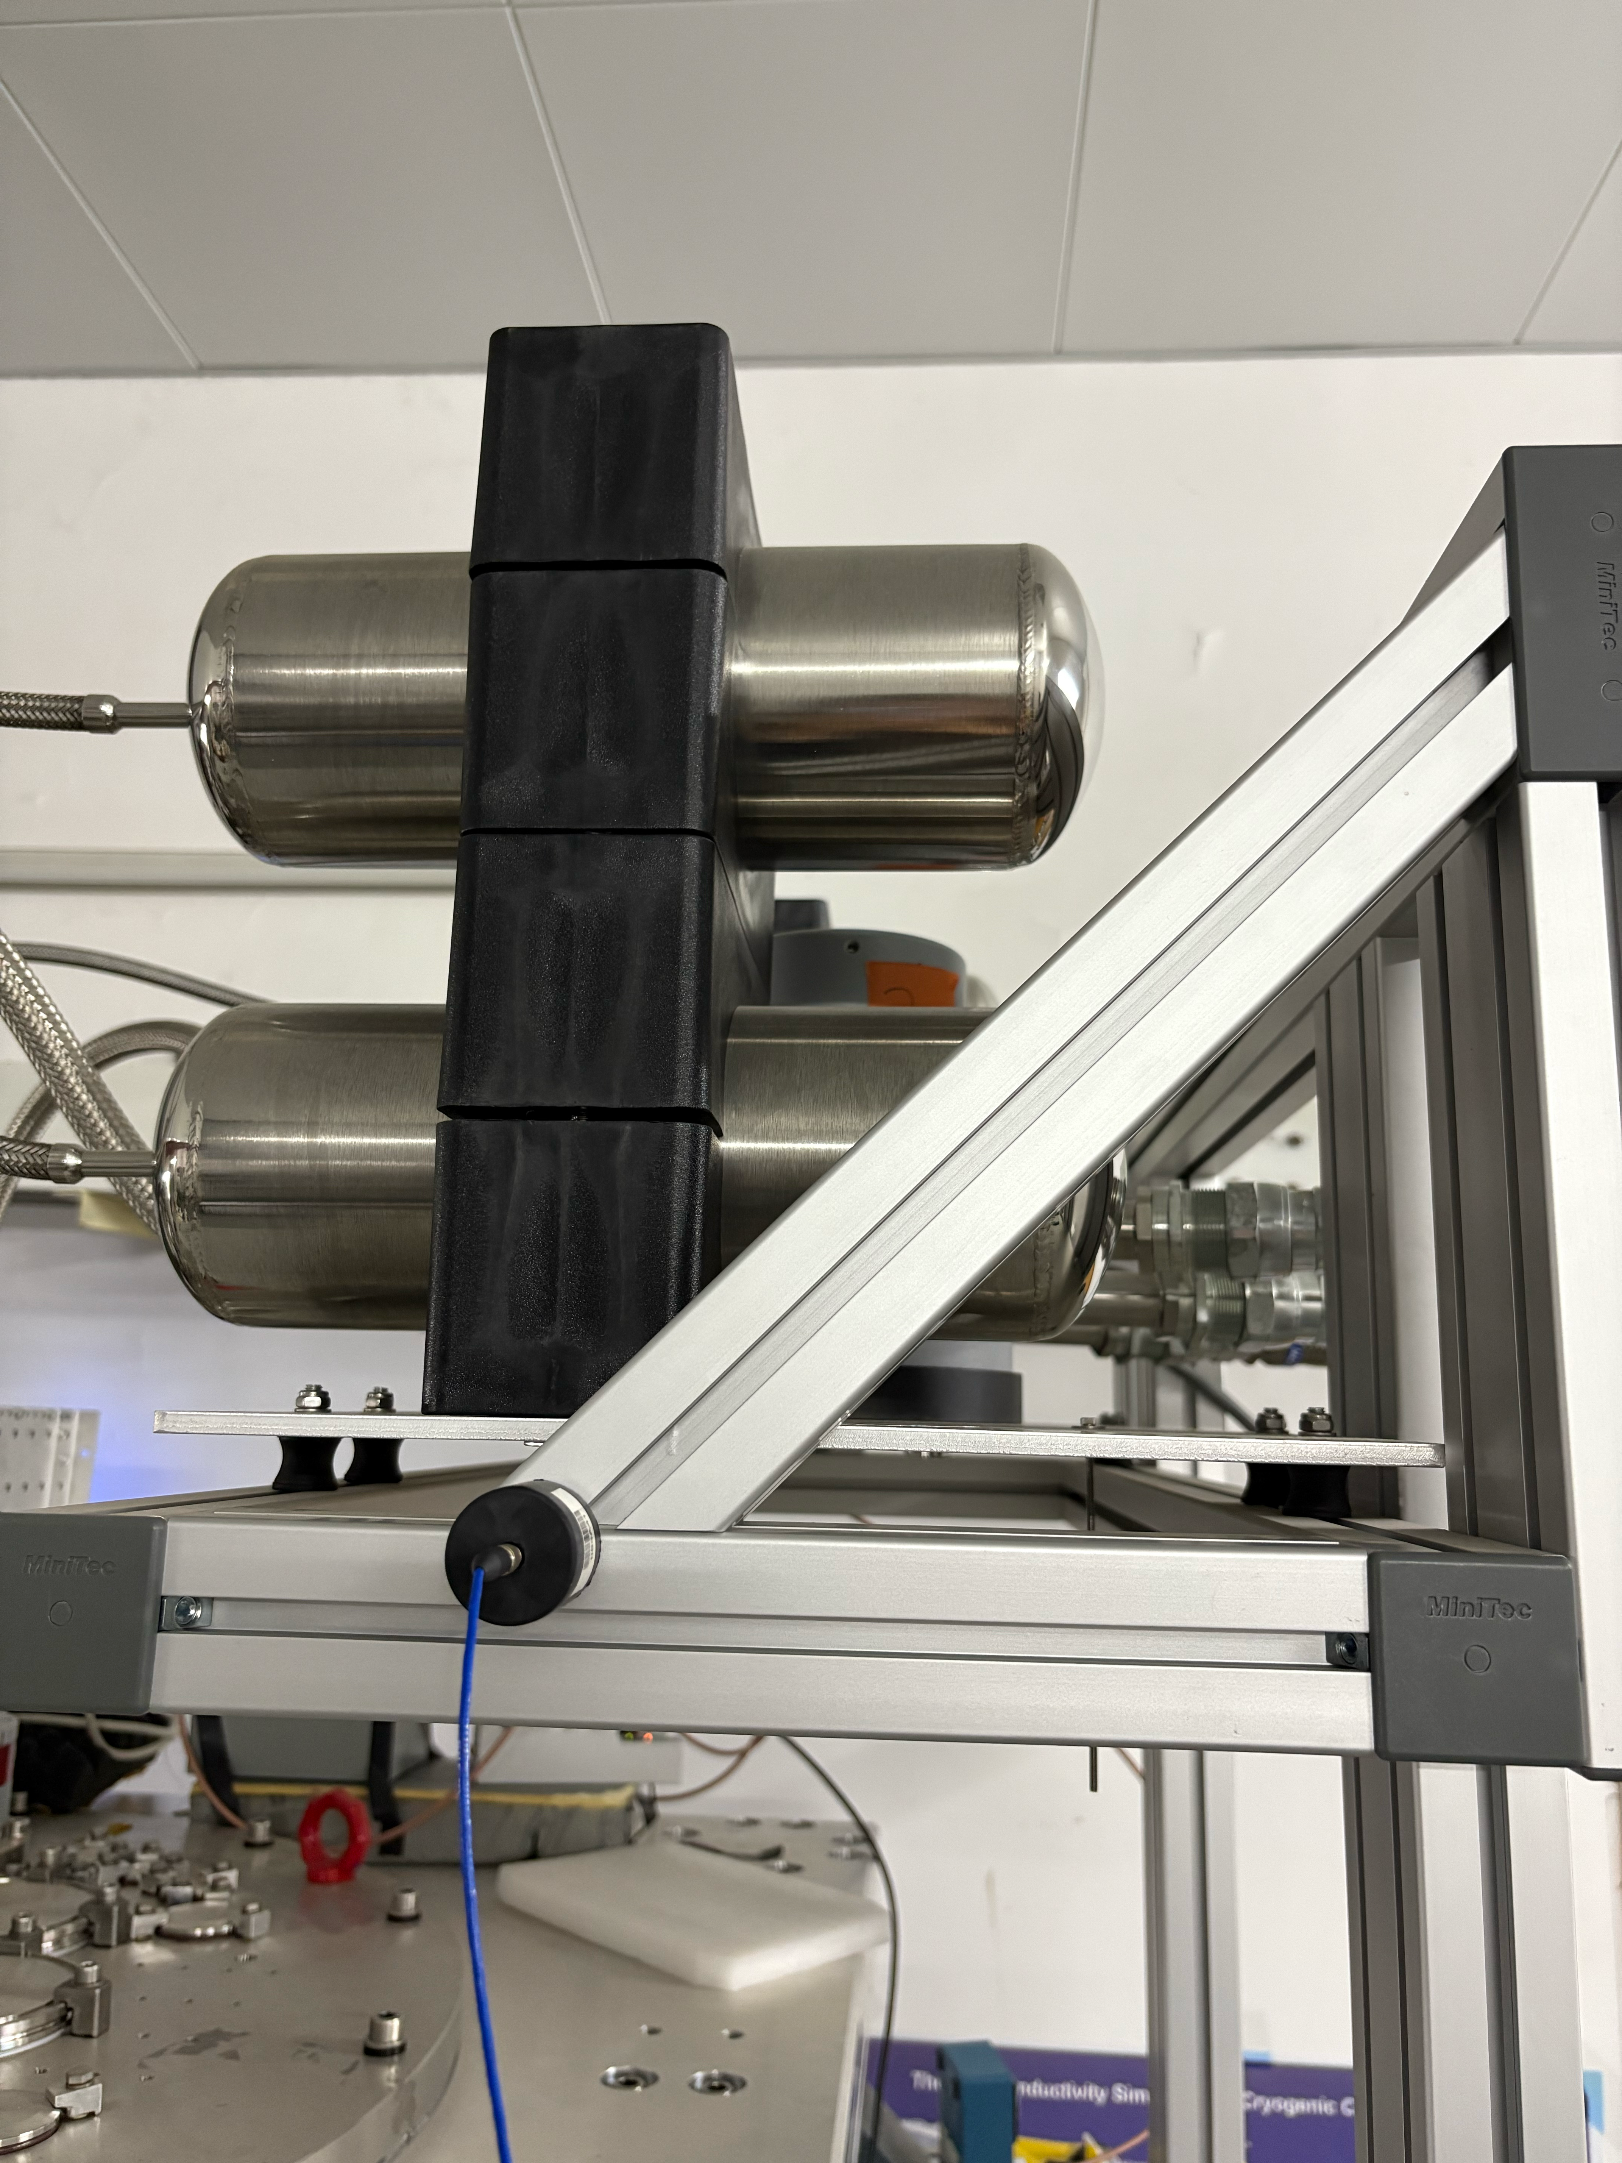
PT vibration
轴向 VS 径向
pt_board
pt_board_r

Slide 52
准零刚度隔离器（Quasi-zero Stiffness, QZS）

Slide 53
振
m

Slide 54
振
m

Slide 55
振
m

Slide 56
振
m

Slide 57
振
m

Slide 58
Back up

Slide 59
总结：单个频率、无阻尼
m=1kg，外部激励频率 W=1rad/sec，Amplitude=6

Slide 60
总结：单个频率、无阻尼
m=1kg，外部激励频率 W=1rad/sec，Amplitude=6.
无阻尼，K越大，传递率越小！

